Slide 1
Sprint 1
Team Members: John B., Nico L., Nick M.
Scrum Master: Nico L.
Sprint period: 9/7/23 - 10/5/23
Team advisor: Dr. Fu

Slide 2
Sprint 1 Goal
Original sprint goal: Create a stylish, yet functional user interface and show its functionality. Additionally, show monitor.c and log.c working from the command line
Accomplished work: Achieved goal of creating a new GUI that can read information from a file and create nodes accordingly. Their colors can be changed in real time according to the node’s current state. log.c extracts the IP & MAC addresses from all incoming packets on the network interface and logs them in a .txt file, monitor.c scans that .txt file and compares newly received packets with old packets to see if an IP/MAC pairing is changed/spoofed, then displays that information on the GUI.
Sprint percentage completion: 100%

Slide 3
Sprint 1 Goal
Original demo goal: Create nodes randomly and display them on the GUI.
Accomplished demo: GUI can read information from a file and use that to create visual nodes.
Demo percentage completion: 100%

Slide 4
Sprint 1 Nico L. Backlog: (a table for each team member)
# | Task | Original Estimate (hours) | Logged hours | Completion % completed (week completed) | Comment any problems and how you solved them
1 | Search for a suitable UI template | 5 | 5 | 100% (Week 1) | Netbeans wouldn’t recognize template UI on Nico’s machine. Verifying proper file was downloaded fixed this issue.
2 | Get template UI running in the NetBeans IDE to work on | 2 | 7 | 100% (Week 2)
3 | Get UI to interface from log.txt (display the ARP data table on nodes within UI) | 6 | 3 | 65% (Week 3) | Easier solution found- Instead made the UI interface with monitor.c (John’s program) which works by reading the data within log.txt (Nico’s program)
4 | Create tab in UI for displaying log.txt | 6 | 5 | 100% (Week 4)
Total |  | 19 | 20 | 91%

Slide 5
Sprint 1 John B. Backlog:
# | Task | Original Estimate (hours) | Total actual hours | Completion (week completed or % completed) | Comment any problems and how you solved them, new issues added later
1 | Search for a suitable UI template | 5 | 4 | 100% (Week 1)
2 | Additional work on monitor.c to have it be able to connect to UI | 3 | 4 | 50% (Week 2) | Log.c, which monitor.c depends on, wouldn’t work properly. Had to set aside time to fix the issues with this program.
3 | Get log.c working on John's VM (program fully written and fully working on Nico's host machine) | 4 | 3 | 100% (Week 3)
4 | Continue compatibility work on monitor.c | 5 | 6 | 100% (Week 4)
Total |  | 17 | 17 | 87.5%

Slide 6
Sprint 1 Nick M. Backlog:
# | Task | Original Estimate (hours) | Total actual hours | Completion (week completed or % completed) | Comment any problems and how you solved them
1 | Search for a suitable UI template | 5 | 4 | 100% (Week 1)
2 | Modify the template UI with the ability to draw nodes and handle right-click events | 4 | 9 | 100% (Week 3)
3 | Continue developing UI (Nodes currently printed randomly and movable, get them to format 4x4 and static) | 6 | 8.5 | 100% (Week 3) | Node buttons had to be hovered over before changing color, changing them to be JLabels instead solved this issue
4 | Debug User Interface and work on having it create nodes from a file instead of just randomly generating them | 5 | 7 | 100% (Week 4) | Some methods couldn’t be called from main because they were non-static. They had to be reformatted to be called from a static context.
Total |  | 20 | 28.5 | 100%

Slide 7
Sprint 1 All: (totals about each team member – see example below)
# | Name | Sum Estimated Hours | Estimated hours/Team total | Sum Logged Hours | logged hours/Team total | Completion percentage tasks per person
 | John B. | 17 | 17/56 (30%) | 17 | 17/65.5 (26%) | 87.5%
 | Nico L. | 19 | 19/56 (34%) | 20 | 20/65.5 (31%) | 91%
 | Nick M | 20 | 20/56 (36%) | 28.5 | 28.5/65.5 (43%) | 100%
Team Total/average |  | sum = 56 |  | sum = 65.5 |  | 92.8%

Slide 8
Sprint 1 issues – things you had to change/add/didn’t work and your actions and results
 | Issue | Person(s) responsible | Situation | Action (change backlog, change specification, change design, etc) | Result (solved, partially solved, moved later)
 | Could not run Nick’s Java Netbeans UI on Nico’s PC | Nico, Nick | Netbeans program ran on Nick’s machine but not Nico’s | Change backlog- merged GitHub template with Nick’s changes Change design- started using shared version of program with merges | Solved
 | Could not compile log.c on John’s VM | John, Nico | log.c compiles and ran on Nico’s host machine but John got errors | Change design - Nico fixed the program (required compilation with -lpcap and required running with sudo) | Solved
 | Made UI interface with log.txt instead of monitor.c | Nico | Nico was trying to make the UI nodes read the data from log.txt directly, when the less redundant solution was making the UI read monitor.c | Change backlog | Solved
 | Total: 3 Issues |  |  |  | Percentage Issues solved without delay: 100%

Slide 9
Sprint retrospective meeting (last meeting of the sprint)
Conclusions at the end of the Sprint:
We were able to reach the goal for the main sprint as well as the deliverables for a working demo
We found it faster to troubleshoot our issues when we met in person instead of online, as the person most capable of solving the problem would have hands-on access to the other person’s host machine and grasp the whole picture of the issue instead of just hearing it described verbally.
Positive: We used a shared Google Drive for maintaining the latest working build of our programs. If someone had a problem with their local copy of a program, we would always have a backup of the latest working build for them to download.
Negative: With everyone working on their own individual program, everyone only understood the code for the program that they alone wrote. If there were compilation/runtime errors, only the person who wrote the program would know the solution.
For the next sprint we will put a stronger emphasis on documentation and we will start doing code reviews on top of functionality testing to ensure team members are familiar with the codebases of the programs they didn’t originally author. Additionally, we will make use of remote access software instead of Discord for more efficient problem solving.

Slide 10
Summary Sprint 1
Select one:
1. Excellent progress
2. Very good progress
3. Good progress
4. Little to no progress
If you select 3 or 4, explain below:
Cause :
Actions:
Lesson learned:
X

Slide 11
Next Sprint plan
Sprint Master
Nick Masci
Sprint Goal
Debug, QOL changes (radio buttons for saving iptables blocklist after reboot & option for automatic vs manual blocking), testing with Metasploit ARP attack
Sprint Demo Goal
Show a real ARP poisoning attack launched via Ettercap that gets detected & blocked within the UI.

Slide 12
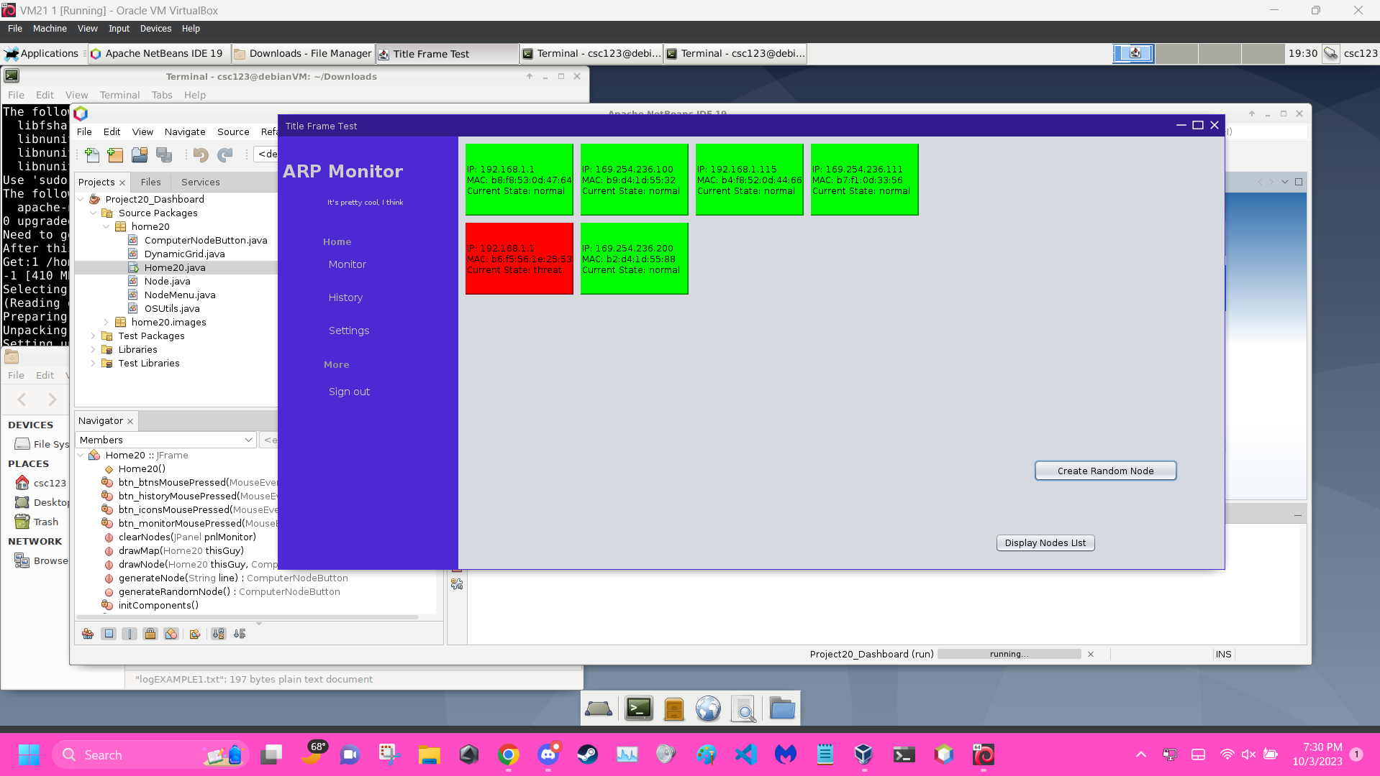
Sprint Demo

